Slide 1
Convolutional Neural Networks (CNNs)
Deep Learning for Image and Signal Processing
Notes:
Introduce the concept of CNNs and their importance in deep learning. Explain how they are inspired by the human brain and are used for various tasks. Ask students if they have heard of CNNs before and what they know about them.

Slide 2
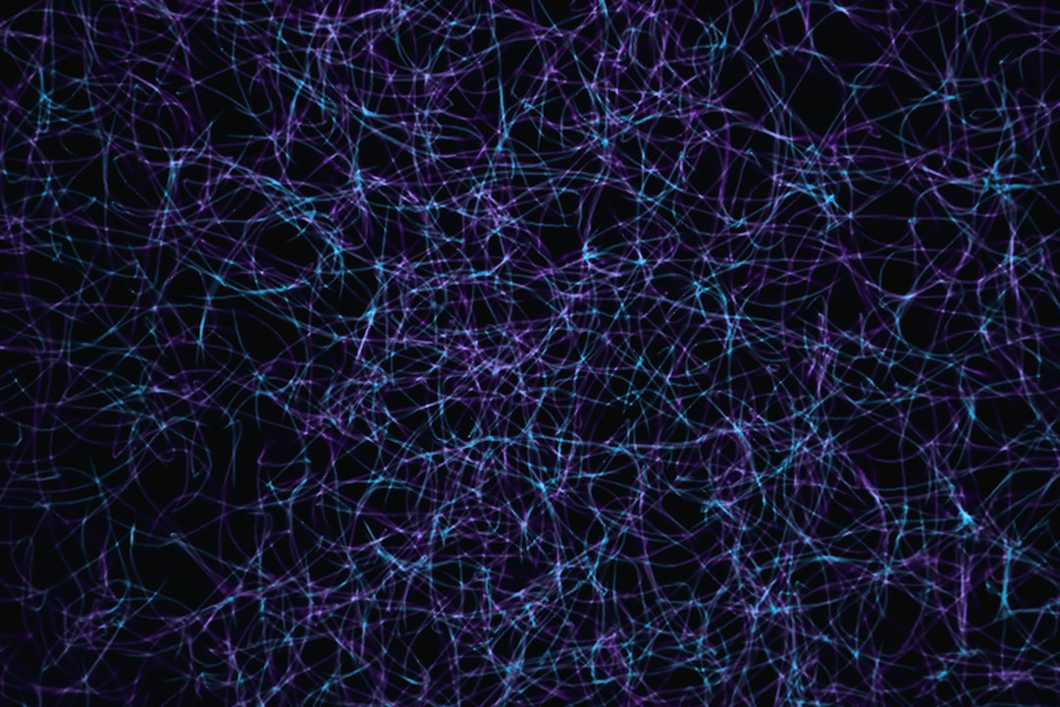
Architecture
Consist of convolutional and pooling layers
Followed by fully connected layers
Use activation functions like ReLU and sigmoid
Image_query: CNN architecture diagram
y = σ(Wx + b)
Can be trained using backpropagation
Regularization techniques are often used
Batch normalization can improve training
Dropout can prevent overfitting
Notes:
Explain the basic architecture of a CNN, including the convolutional and pooling layers. Discuss the importance of activation functions and how they are used. Show an image of a CNN architecture diagram and explain each component. Ask students to think about how the architecture of a CNN allows it to learn complex patterns.

Slide 3
Convolution and Pooling
Convolutional layers extract local features
Pooling layers reduce spatial dimensions
Max pooling is a common pooling technique
Average pooling can also be used
Stride and padding can be adjusted
Convolutional layers can be stacked
Pooling layers can be used for downsampling
Helps to reduce the number of parameters
Improves the robustness of the model
Notes:
Dive deeper into the convolutional and pooling layers of a CNN. Explain how convolutional layers extract local features and how pooling layers reduce spatial dimensions. Discuss the different types of pooling techniques and how they can be used. Ask students to think about how the convolutional and pooling layers work together to learn complex patterns.

Slide 4
Applications
Image classification and object detection
Segmentation and generation tasks
Natural language processing tasks
Speech recognition and synthesis
Used in self-driving cars and robotics
Used in medical image analysis
Used in facial recognition systems
Can be used for recommender systems
Can be used for time series forecasting
Notes:
Discuss the various applications of CNNs, including image classification and object detection. Explain how CNNs can be used for segmentation and generation tasks, as well as natural language processing tasks. Provide examples of how CNNs are used in real-world applications, such as self-driving cars and medical image analysis. Ask students to think about other potential applications of CNNs.

Slide 5
Advantages and Limitations
Can learn complex patterns and features
Robust to small transformations and noise
Can be trained on large datasets
Can be used for real-time applications
Require large amounts of computational power
Can be prone to overfitting
Can be sensitive to hyperparameters
Can be difficult to interpret
Can be biased towards certain classes
Notes:
Summarize the advantages and limitations of CNNs. Discuss how CNNs can learn complex patterns and features, but require large amounts of computational power. Explain how CNNs can be prone to overfitting and sensitive to hyperparameters. Ask students to think about how the advantages and limitations of CNNs can be addressed in real-world applications. Provide a summary of the key takeaways from the previous slides.

